Slide 1
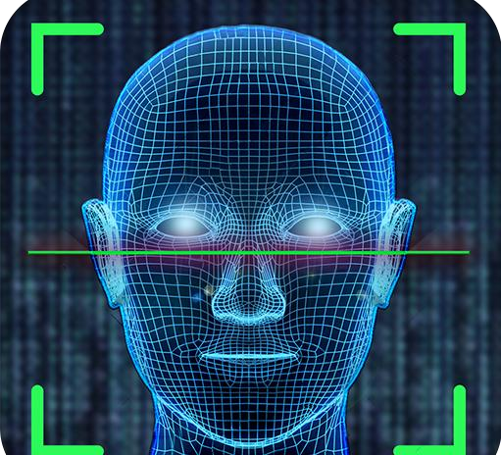
FACELOCK ALGORITHM
ARPIT GAUR
18015001004
ARUN KUMAR
19015001902
RAVI SHARMA
18015001017

Slide 2

PROBLEM
STATEMENT
The security of applications in mobile phones or websites is always a major issue to ensure the security and privacy, we designed a Machine Learning Algorithm which will only unlock the application or website when it will scan your face.

Slide 3

OBJECTIVE AND SCOPE
It will first take the training data as an input from the camera of the device and then will train the model from the input and will detect the face according to that training of the model
The objective of the project is to provide user an algorithm which will detect the face of the user and unlock the applications or websites according to that.

Slide 4
SOFTWARE USED
Python :- We have used python latest version “ 3.8.5” in the project.
OpenCV :- OpenCV (OPEN SOURCE COMPUTER VISION) is an open-source BSD- licensed library that includes several hundreds of computer vision algorithms. We will use many methods of opencv in this project.
Anaconda :- Anaconda Enterprise is an enterprise-ready, secure, and scalable data science platform that empowers teams to govern data science assets, collaborate, and deploy data science projects.

Slide 5

HARDWARE USED
A W I N D OW S S YS T E M W I T H W E B C A M I N I T.

Slide 6
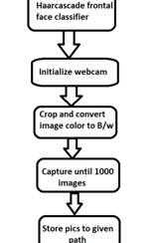
METHODOLOGY
WORKFLOW OF MODULE 1

Slide 7
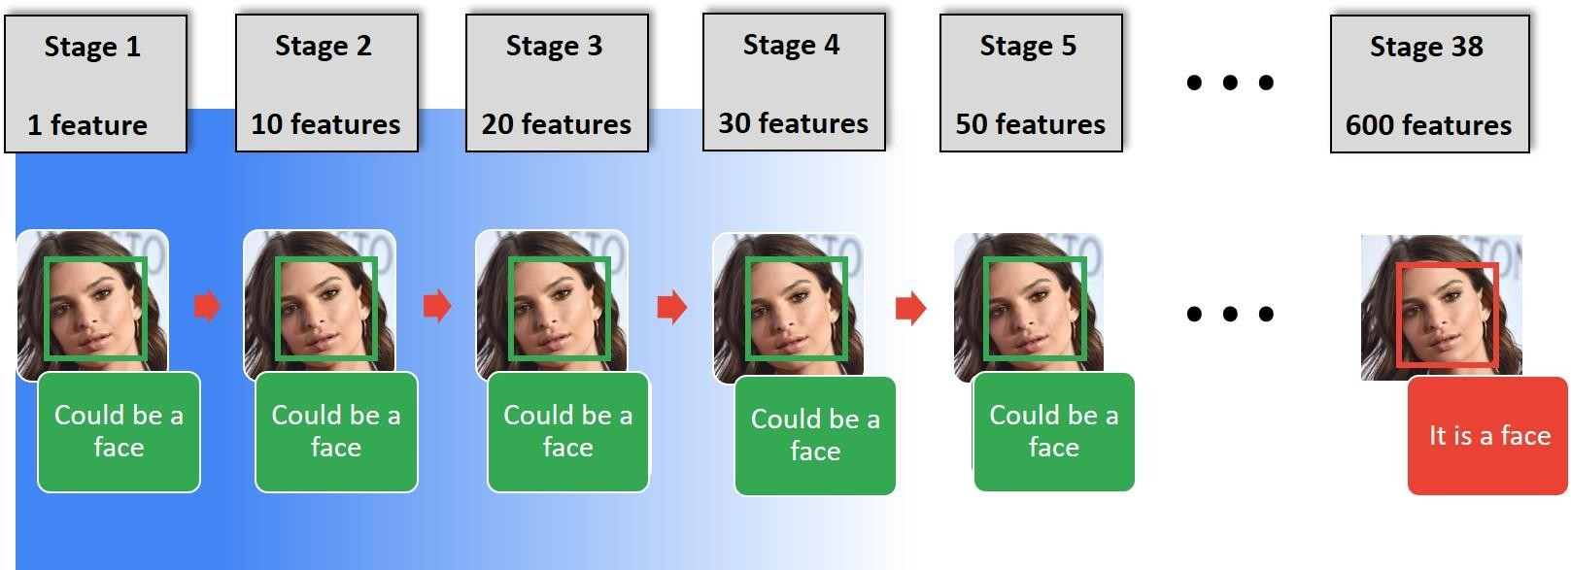
This is basically a machine learning based approach where a cascade function is trained from a lot of images both positive and negative. Based on the training it is then used to detect the objects in the other images.
ABOUT HARCASCADE CLASSIFIER

Slide 8
1. FACE DETECTION
using haarcascade_frontalface_default.xml
2. FACE AND EYE DETECTION using haarcascade_eye.xml
USECASES OF HARCASCADE CLASSIFIERS
3. VEHICLE DETECTION FROM STREAMING VIDEO using haarcascade_car.xml
4. PEDESTRIAN DETECTION FROM STREAMING VIDEO
using haarcascade_fullbody.xml

Slide 9
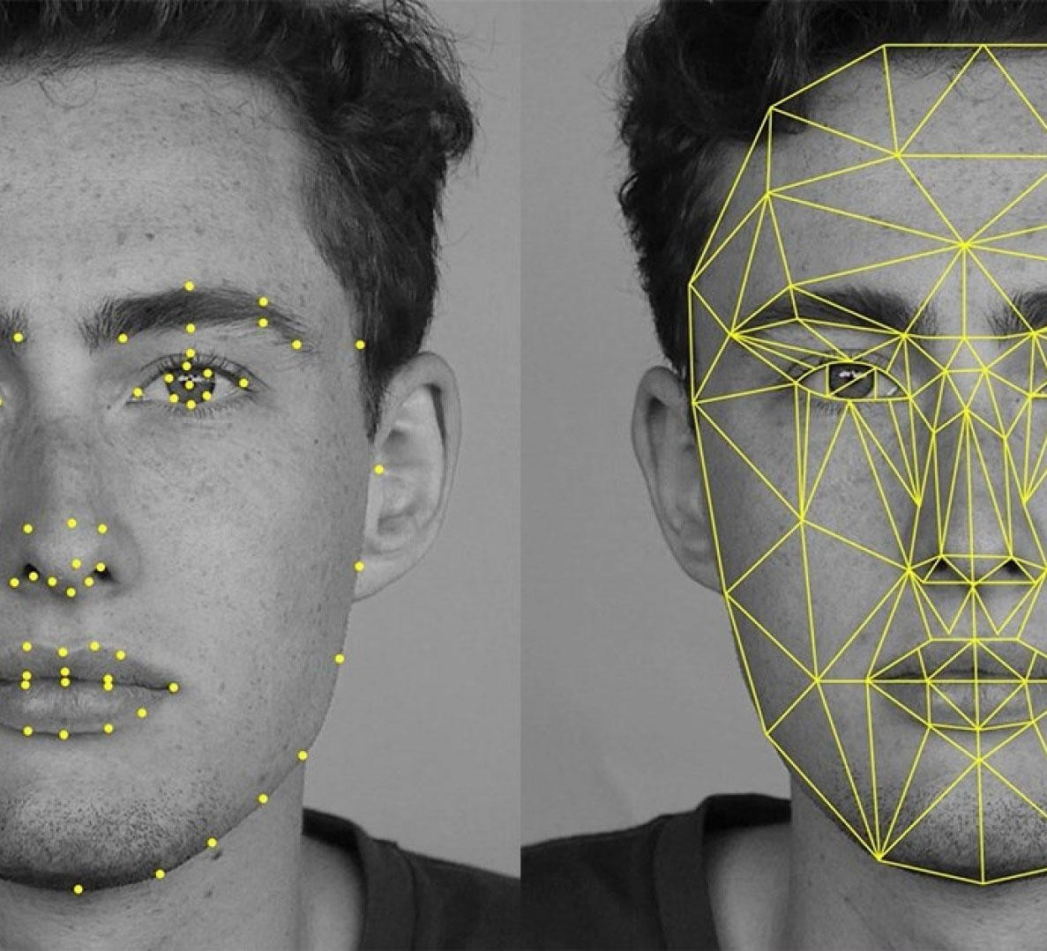
HARCASCADE FRONTAL FACE CLASSIFIER
It is used to detect only the front face of the user and eliminates all the background details

Slide 10
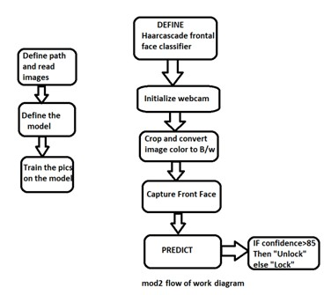
METHODOLOGY
WORKFLOW OF MODULE 2

Slide 11

ABOUT LBPH MODEL
Local Binary Pattern (LBP) is a simple yet very efficient texture operator which labels the pixels of an image by thresholding the neighborhood of each pixel and considers the result as a binary number.
It was first described in 1994 (LBP) and has since been found to be a powerful feature for texture classification. It has further been determined that when LBP is combined with histograms of oriented gradients (HOG) descriptor, it improves the detection performance considerably on some datasets.

Slide 12
Radius: the radius is used to build the circular local binary pattern and represents the radius around the central pixel. It is usually set to 1.
Neighbors: the number of sample points to build the circular local binary pattern. Keep in mind: the more sample points you include, the higher the computational cost. It is usually set to 8.
PARAMETERS OF LBPH ALGORITHM
Grid X: the number of cells in the horizontal direction. The more cells, the finer the grid, the higher the dimensionality of the resulting feature vector. It is usually set to 8.
Grid Y: the number of cells in the vertical direction. The more cells, the finer the grid, the higher the dimensionality of the resulting feature vector. It is usually set to 8.

Slide 13
TRAINING THE LBPH ALGORITHM
First, we need to train the algorithm. To do so, we need to use a dataset with the facial images of the people we want to recognize. We need to also set an ID (it may be a number or the name of the person) for each image, so the algorithm will use this information to recognize an input image and give you an output. Images of the same person must have the same ID.

Slide 14
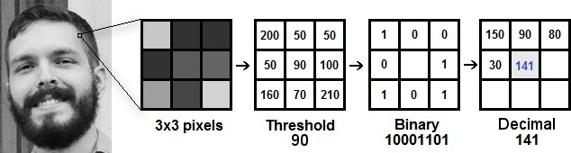
APPLYING THE LBPH OPERATION
The first computational step of the LBPH is to create an intermediate image that describes the original image in a better way, by highlighting the facial characteristics. To do so, the algorithm uses a concept of a sliding window, based on the parameters radius and neighbor s.

Slide 15
APPLYING LBPH---CONTD--------
For each neighbor of the central value (threshold), we set a new binary value. We set 1 for values equal or higher than the threshold and 0 for values lower than the threshold.
Now, the matrix will contain only binary values (ignoring the central value). We need to concatenate each binary value from each position from the matrix line by line into a new binary value (e.g. 10001101).
we need take the central value of the matrix of pixel values to be used as the threshold.
At the end of this procedure (LBP procedure), we have a new image which represents better the characteristics of the original image.
Then, we convert this binary value to a decimal value and set it to the central value of the matrix, which is actually a pixel from the original image.

Slide 16
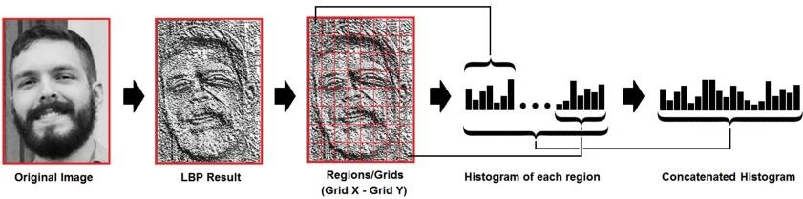
Now, using the image generated in the last
EXTRACTING HISTOGRAMS IN LBPH
step, we can use the Grid X and Grid
Y parameters to divide the image into multiple grids

Slide 17
1. So to find the image that matches the input image we just need to compare two histograms and return the image with the closest histogram.
We can use various approaches to compare the histograms (calculate the distance between two histograms), for example: euclidean distance, chi- square, absolute value, etc.
So the algorithm output is the ID from the image with the closest histogram. The algorithm should also return the calculated distance, which can be used as a ‘confidence’ measurement
FACE RECOGNITION BY LBPH

Slide 18
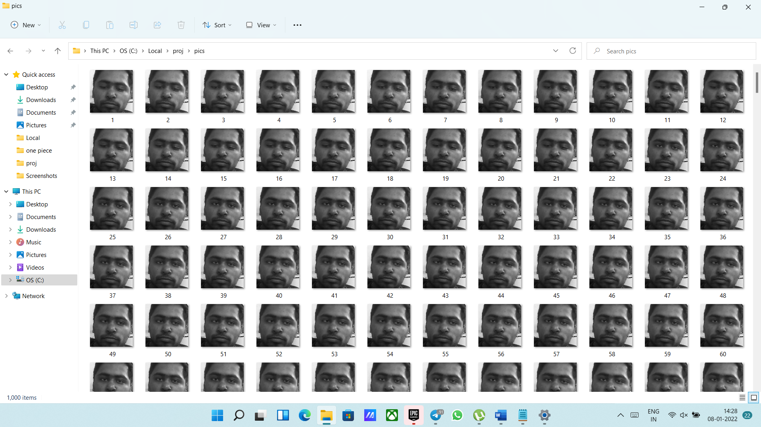
SCREENSHOTS
This screenshot shows capturing 1000 images of the user to be used as dataset

Slide 19
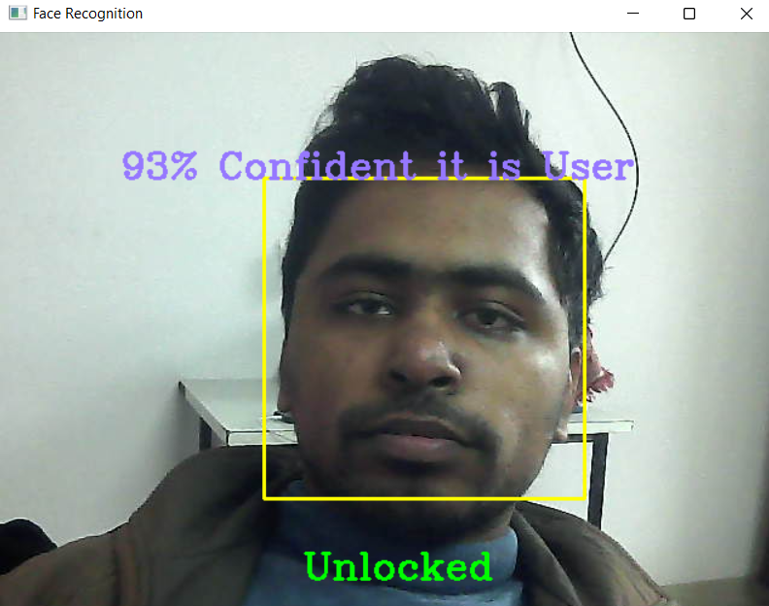
RESULTS AND OUTCOMES
This snapshot shows the application being unlocked because the confidence is greater than 85%

Slide 20

https://docs.opencv.org/3.4/df/d25/class cv_1_1face_1_1LBPHFaceRecognizer.h tml
Facelock: familiarity-based graphical authentication
Research article
References
Human-Computer Interaction
Psychiatry and Psychology
Rob Jenkins¹, Jane L. McLachlan², Karen Renaud³
Published June 24, 2014

Slide 21
THANK YOU

